Slide 1
Laboratoire Sols Solides Structures Risques
Notes:
Voici les infos de la semaine :

Slide 2
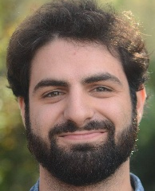
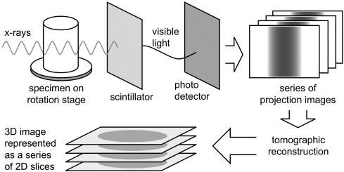
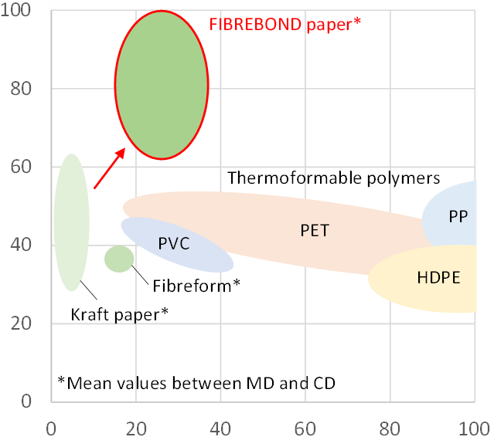
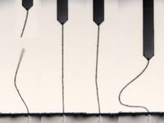
Julien Clauzon
Thèse, 2024 – 2027
3SR Lab (Sabine Rolland du Roscoat)
LGP2 (Raphaël Passas, Quentin Charlier)
Caractérisations multi-échelle de l’hygro-mécanique des matelas fibreux
Multiscale Characterization of the Hygro-Mechanics of the Fiber Mats
Context
Method
Packaging industry:
140 MT of non-degradable
petroleum based polymers
worldwide in 2021.
Paper:
It is an alternative but is strongly limited by its weak ductility.
To face the growing demand while limiting its environmental impact, the paper industry must reduce its consumption of energy, water and raw materials.
Goal of this project:
Get a better understanding of the inter-fiber bonds behavior and impact on paper using a multiscale approach.
Study paper at different scale:
Macro scale: paper sheet
Meso scale: fiber network
Micro scale: fibers
Nano scale: inter-fiber bonds
X-ray microtomography
Micromechanical testing
Allows for the 3D reconstruction of samples to study 3 scales at the same time: Fiber network, individual fibers and the fiber contacts.
Equipe CoMHet
E. N. Landis and D. T. Keane (2010)
Ultimate strength (MPa)/density (g.cm⁻³)
Paper should be:
stronger,
extensible,
Lower basis
weight
Mechanical characterization of fibers and individual inter-fiber bonds.
Ultimate strain (%)

