Slide 1
Laboratoire Sols Solides Structures Risques
Notes:
Voici les infos de la semaine :
<number>

Slide 2
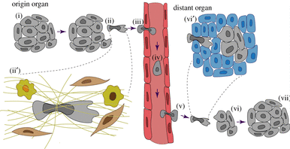
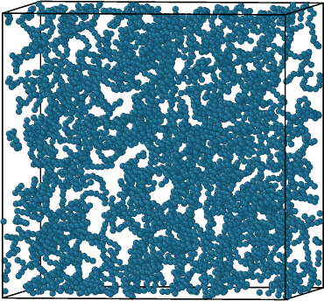
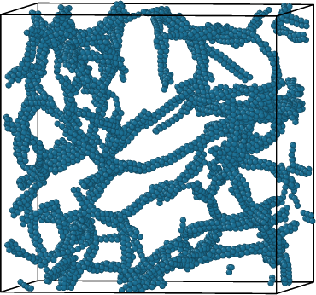
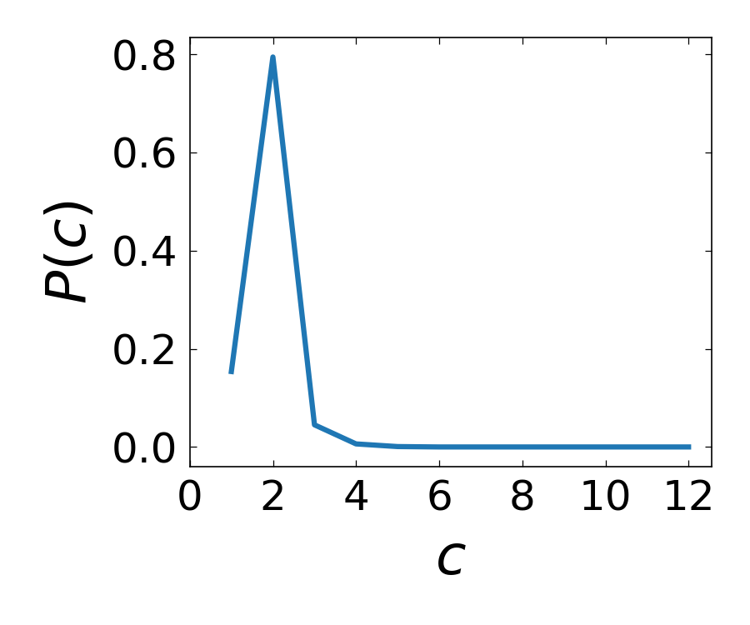
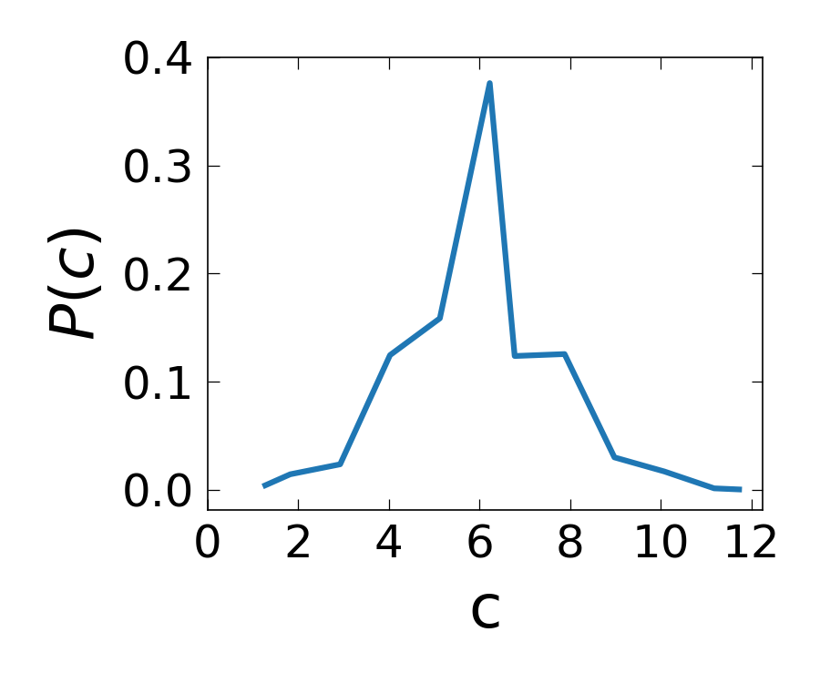
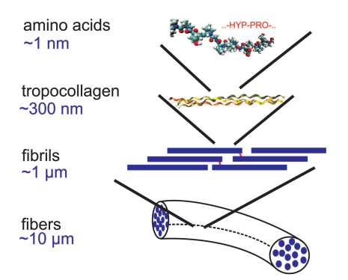
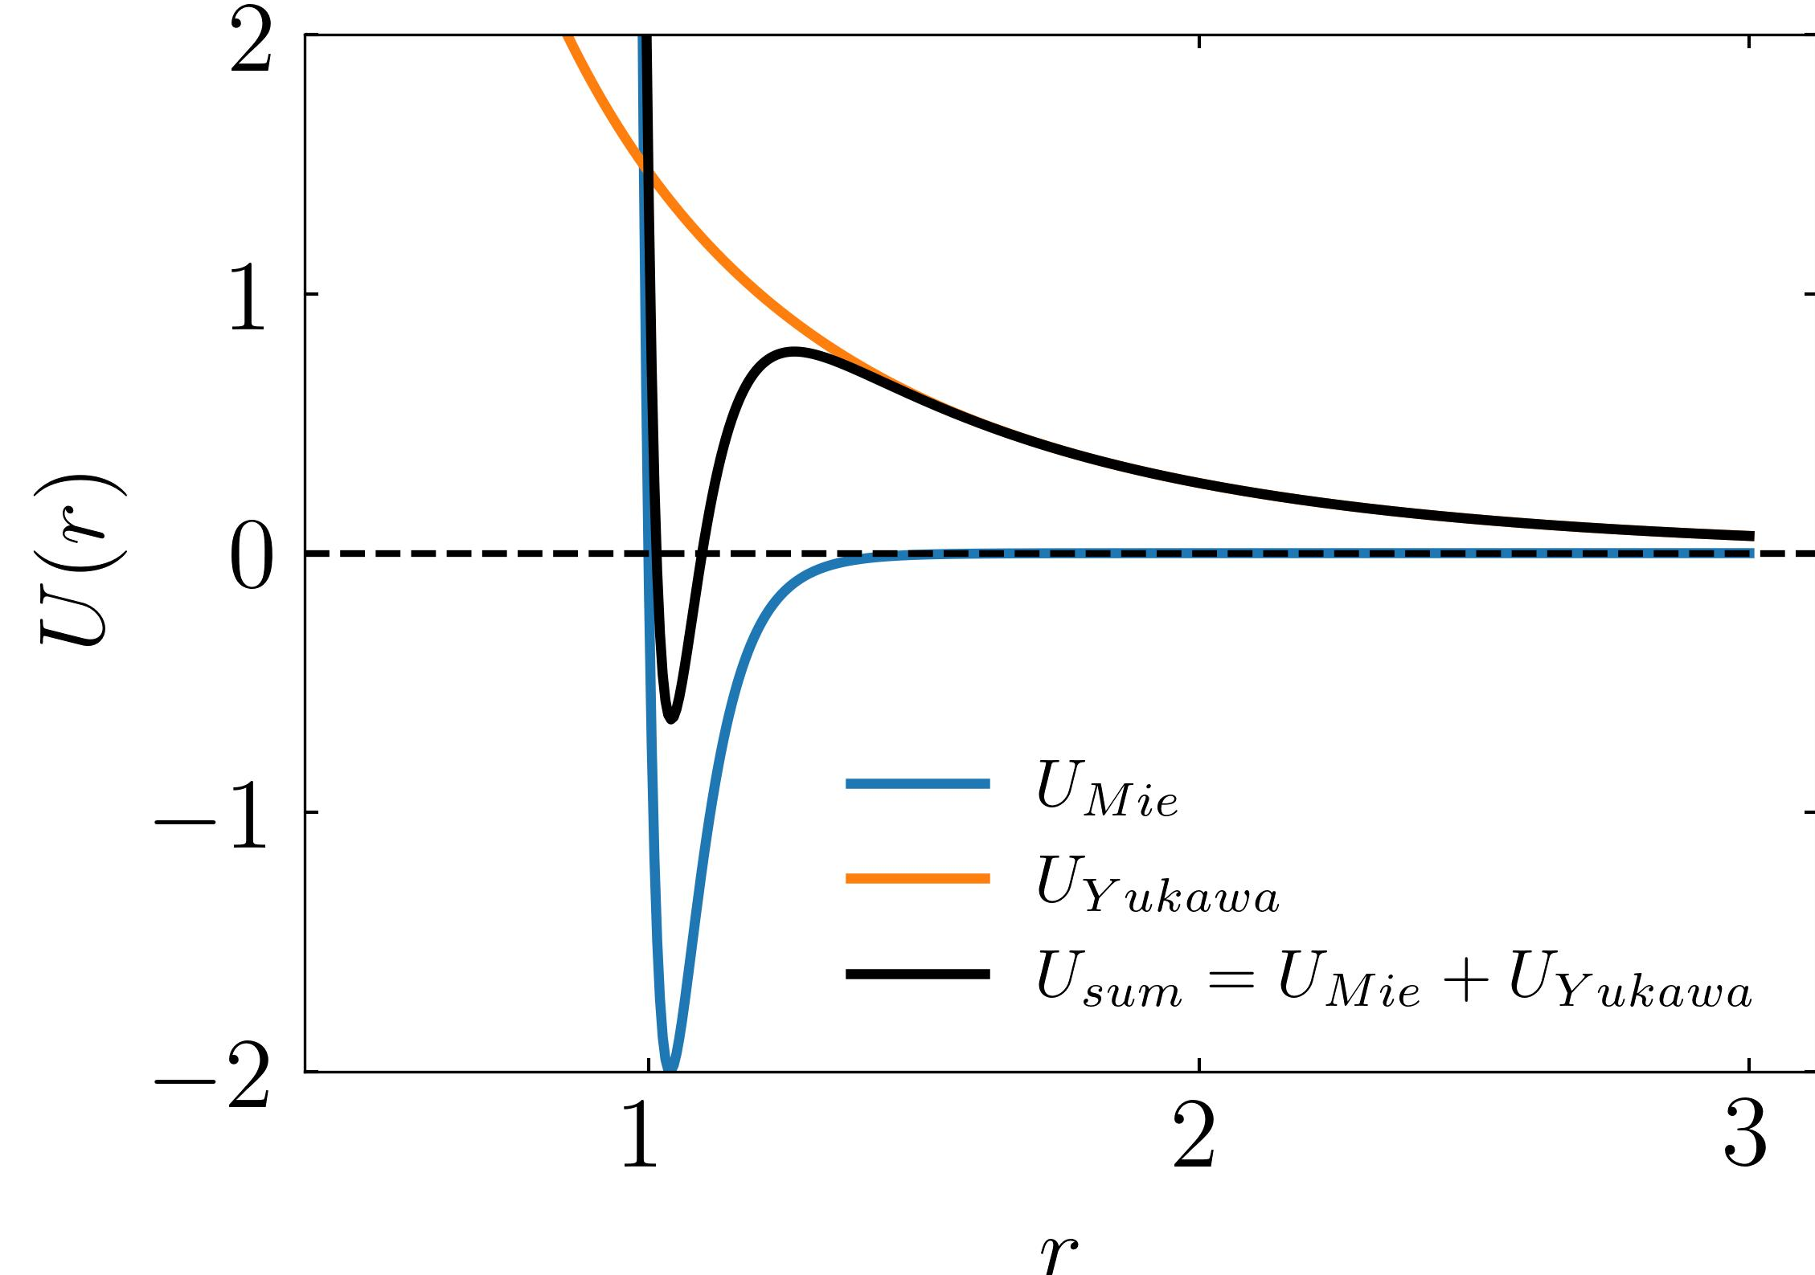
Kamal TRIPATHI
Post-doc, 2023 – 2024
3SR Lab (Dr. Mehdi Bouzid)
LIPHY (Dr. Jocelyn Étienne)
Transmission du stress et fracture des réseaux de collagène
Stress transmission and fracture in collagen networks
Context
Method
Results
Cancer Cell migration
Cancer cells migrate in the body (metastasis) from
one organ to other,
Migration happens through Extra Cellular Matrix
and collagen network is one of the main
components.
The networks will be modelled as a 3D system of N polymer-like chains composed of M spherical monomers whose bonded interactions are given by a finite extensible nonlinear elastic potential (FENE) and an angle potential.
Cooling the system with correct tuning of parameters yields a gel state.
The height of the repulsive shoulder turns out to be one of the most crucial parameters in achieving the percolated network.
Bonded Interaction
T = 1.0 T = 0.1
$U^{b}=−0.5k_{b}R_{0}^{2}ln\left[1−{\left(\frac{r_{ij}}{R_{0}}\right)}^{2}\right]+k_{a}(θ_{ij}−θ_{0})^{2},$
Equipe CoMHet
Non-bonded Interaction
The non-bonded interactions are a combination of Mie and Yukawa Potentials.
Homogenous Gaseous state
Percolated Gel state
Zuela-Sopilniak Noam and Lammerding Jan 2019, Engineering approaches to studying cancer cell migration in three-dimensional environments Phil. Trans. R. Soc.
$U^{nb}\left(r\right)=A\left[{\left(\frac{σ}{r}\right)}^{γ_{rep}}−{\left(\frac{σ}{r}\right)}^{γ_{att}}\right]+B\frac{e^{−κr}}{r}.$
Markus J. Buehler, PNAS, 2006
www.pnas.org/cgi/doi/10.1073/pnas.0603216103
Future Direction
Structural and mechanical characterization of the network are to be explored.

