Slide 1
Laboratoire Sols Solides Structures Risques
Notes:
Voici les infos de la semaine :

Slide 2
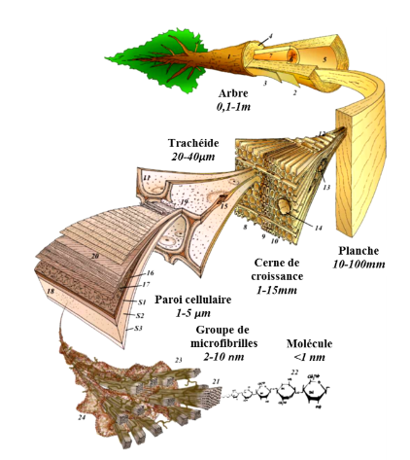
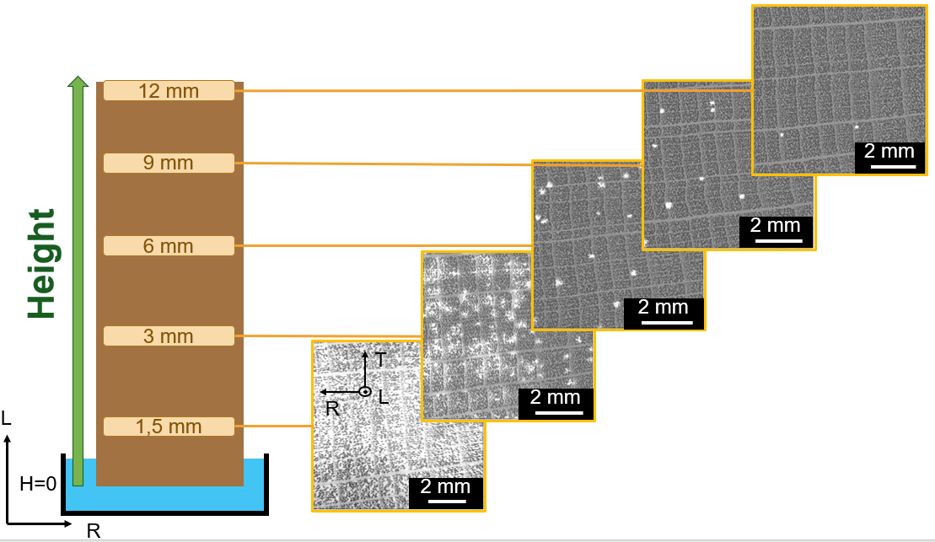
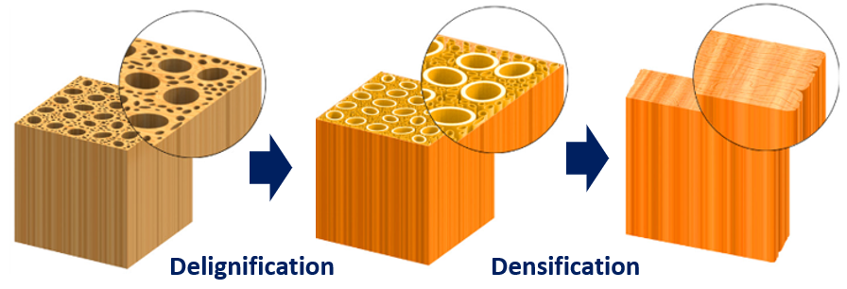
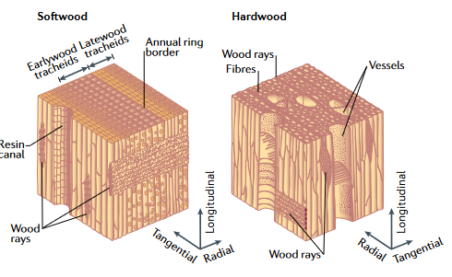
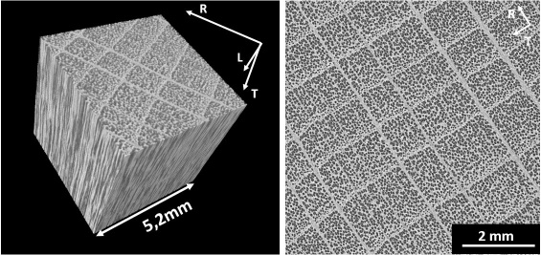
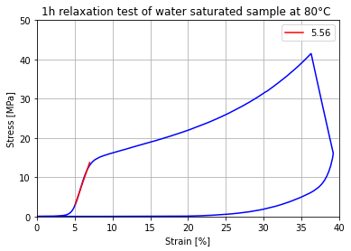
Romain Bordage
Thèse, 2022 – 2023
3SR Lab Sabine Rolland du Roscoat
Laurent Orgéas
CERMAV Yoshiharu Nishyiama
Vers un bois plus fort et plus propre que les composites structuraux actuels
Toward cleaner and stronger wood than current structural composites
Context
Method
Densified Wood elaboration
Water Transport in Wood
Segmentation and Volume correlation
Wood is a multi-structural and natural material composed of 40% of cellulose. Cellulose has outstanding mechanical properties, but bulk wood has lower properties and is a water-sensitive material. These issues limit wood application.
Process composed of two main treatments:
- Delignification which required perfect wood imbibition
- Thermo-Mechanical pressing
Equipe CoMHet
Figure 1 : Multiscale of wood
Figure 5 : Following of waterfront inside wood during imbibition test
Figure 2 : Microscale of wood
Using Image J for segmentation and SPAM for registration and volumic correlation
Following water transport in wood
Figure 3 : Steps of densified wood elaboration
X ray Tomography
Wood densification is a way of improving mechanical properties and reducing water sensitivity. It could allow to developpe of some structural applications thanks to the low density of the wood. Recently, some research has obtained remarkable mechanical properties for densified wood 1. Their material has properties comparable to some light allows or composite with polymer matrix reinforced by fiber.
Tomography is used to follow (in situ) a water propagation in wood and structural change due to mechanical pressing.
Thermo-mechanical Forming
Mechanical characterization of wood at various moisture content and temperature & Wood architecture of microstructure.
Figure 4 : X ray tomography volume of wood
¹ Song et al. 2018
Figure 5 : Preliminar test of relaxation of Wood

